Slide 1
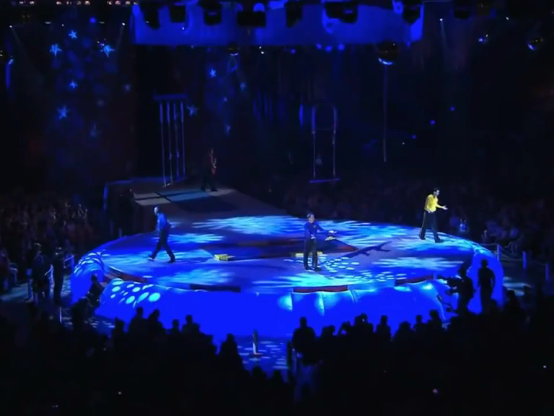
ROCK-A-BYE YOUR BEAR
Everybody clap, (Clap! Clap! Clap!)
Everybody sing, La la la la la!
Bow to your partner,
Then you turn around (Yipee!)
Hands in the air,
Rock-a-bye your bear,
Bear's now asleep, (Shh! Shh! Shh!)
Bear's now asleep, (Shh! Shh! Shh!)
Kangaroo jumps
Boing, boing
Jumps so high
Boing, boing
He almost touches the sky
Boing, boing
Kangaroo jumps so high
Here comes the snake
Hiss, hiss
Slithering along
Hiss, hiss
Body‘s very long
Hiss, hiss
Slippery snake slither along
Wombat crawls
Crawling, crawling
Nose to the ground
Crawling, crawling
He‘s making lots of sound
Crawling, crawling
Crawling everywhere

